Slide 1

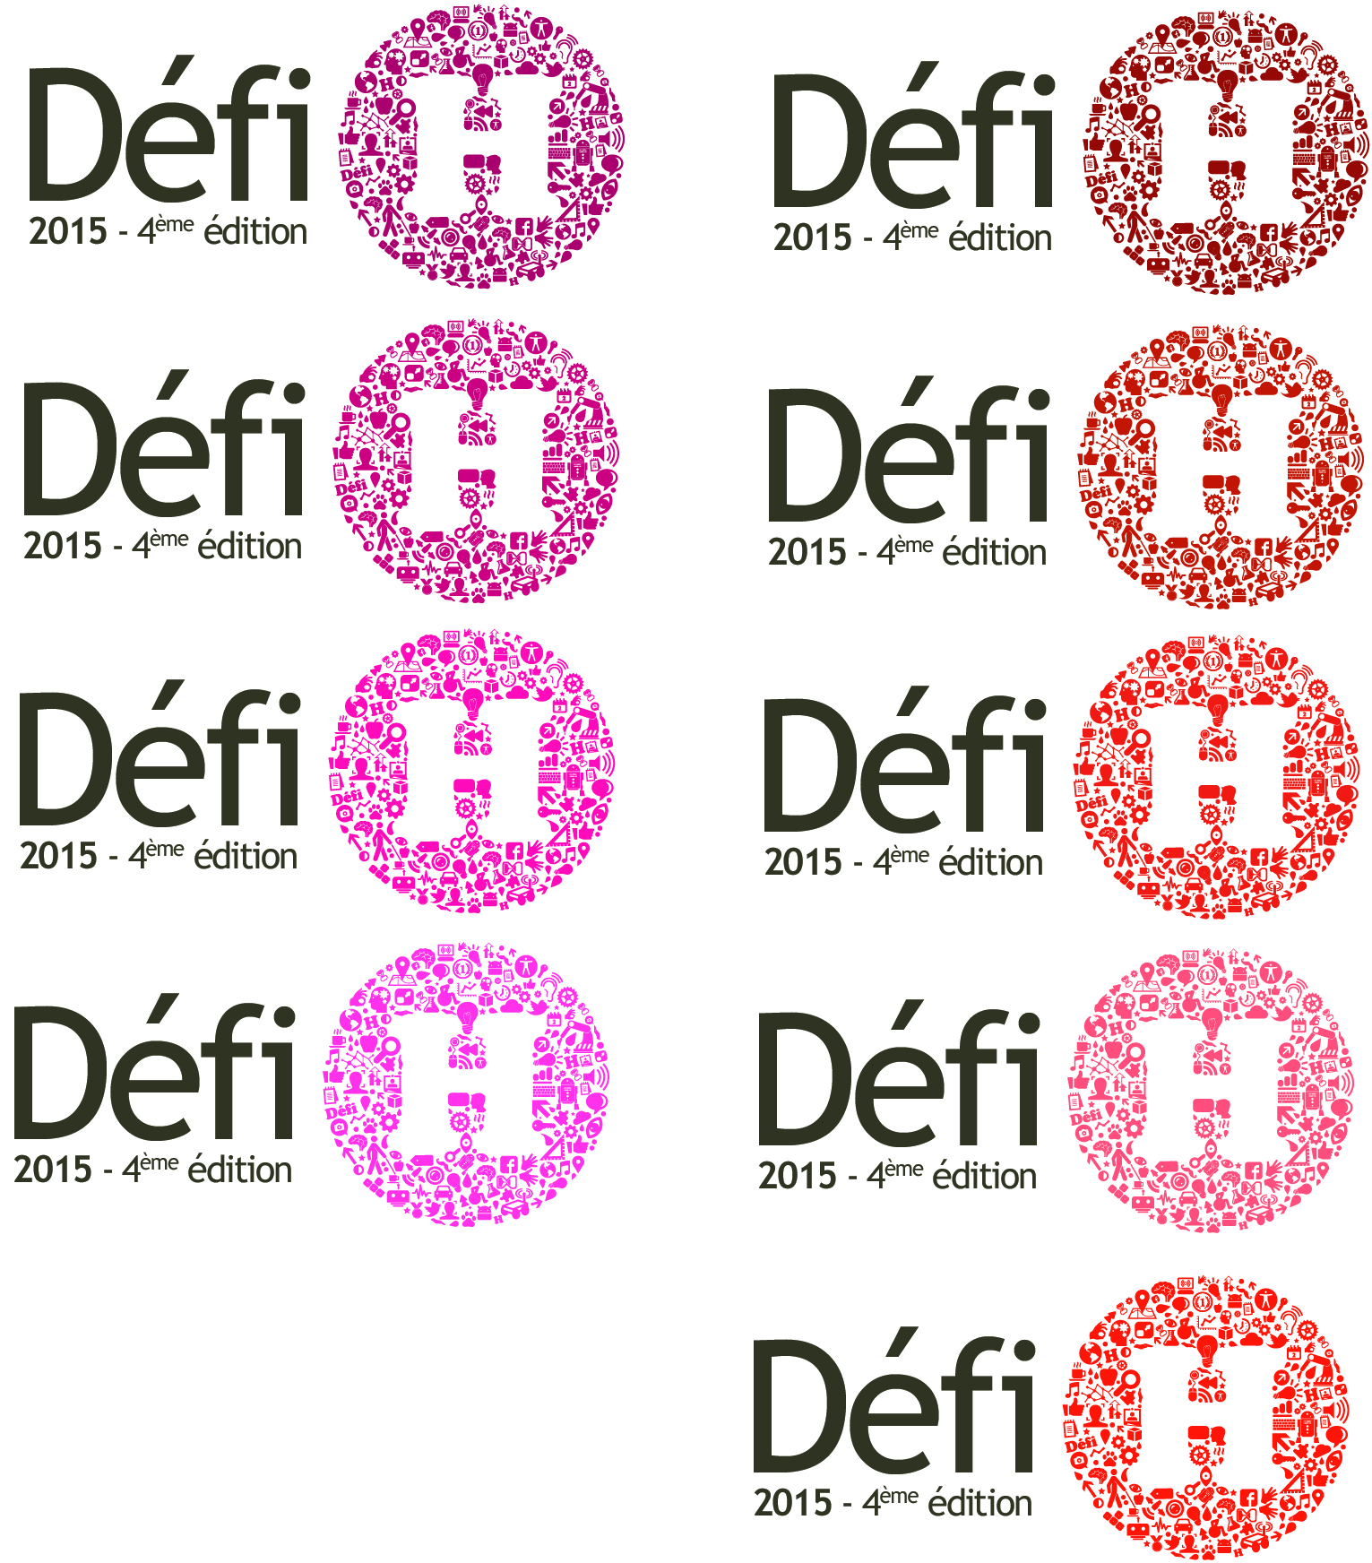






In partnership with:

Slide 2
« It's not that we need new ideas, but we need to stop having old ideas. »
[Edwin Herbert Land]
« An ideal is all the more beautiful when it serves others »
[Le Défi H]

Slide 3
Défi H
The Défi H is the first competition among IT Schools and Universities to empower disabled people.
The students teams work on innovative projects that enable disabled people in the work life.
The teams are made of 4 students, a non-profit organization and a Sogeti coach.
FACTS :
The Défi H was created in 2011.
The 4th edition was launched in September
Sogeti Netherland has launched their 1st edition in September

Slide 4



Défi H : teams
<
1 Sogeti Coach
1 Student Team
1 Non Profit organization
+
+
=

Slide 5



Defi H Roadmap
2011-2012
Pilot
1 media partner LMI
2 disability organisation partners
2012-2013
Consolidation
2 new partners
Paris : new perimeter
( ECE)
Sponsor*
Institutional sponsorship***
2013-2014
Strenthening
Co- Innovation label
New schools participating
Institutional sponsorship***
1 new partner
2015-2016
European Consolidation
Launch in at least 1 other european country
European Final
2014-2015
1st European launched
Project B - Netherland
European partners identification
1 new partner
* Axel LEBLOIS president and executive director of G3ict, UN program for the digital accessibility
** Fleur PELLERIN Minister in charge of small and medium size enterprises, of Innovation and of digital economy
*** Geneviève Fioraso Education & Research State secretary
Serge Haroche 2012 Physic Nobel price

Slide 6
« From a CSR point of view Sogeti is always looking how great CSR activities can be used in other entities. The Defi H project is great because it connects our core business and values with useful innovative IT applications and or appliances. It helps disabled people; generates a positive brand recognition in our target group (students); generates free publicity; creates a great feeling among colleagues and colleagues can actively participate as a coach. And it is a great CSR story to tell to our clients. »
René Speelman, CSR Director Sogeti Group, on why should
we expand the Défi H to other Sogeti countries

Slide 7
Appendix

Slide 8
Schedule
6 months of innovation and communication
Registration begins | September, 16th
Registration deadline | November, 28th
Project Selection by the Selection Committee. | November, 28th
Beginning of the competiton between the 10 selected teams | December, 3rd
Submission of applications (written and 2min video presentations) | April, 25th
2min video and 50 pages final presentation | April, 25
Internal and external vote | April, 28th – May, 12th
Jury decision | May, 13th
Award night in Paris | May, 27th

Slide 9
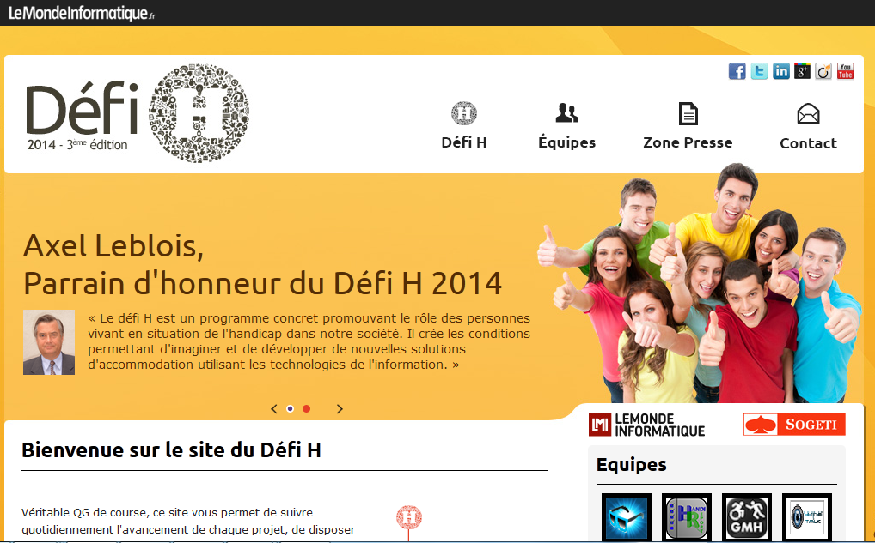
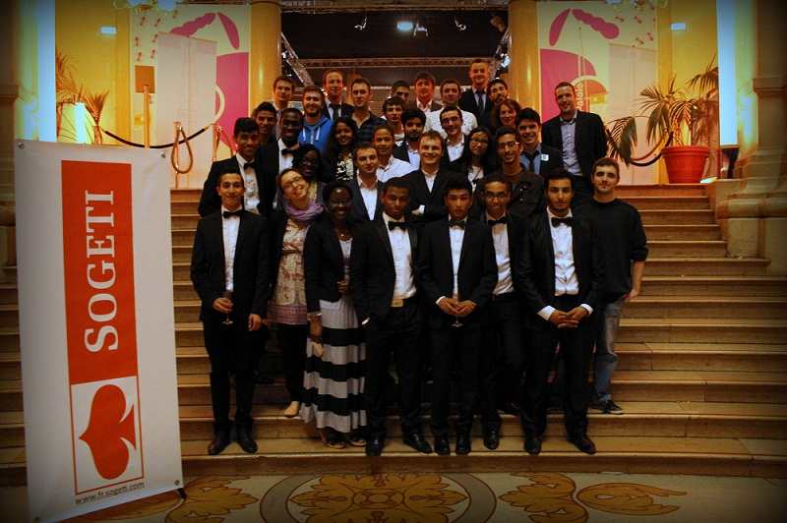
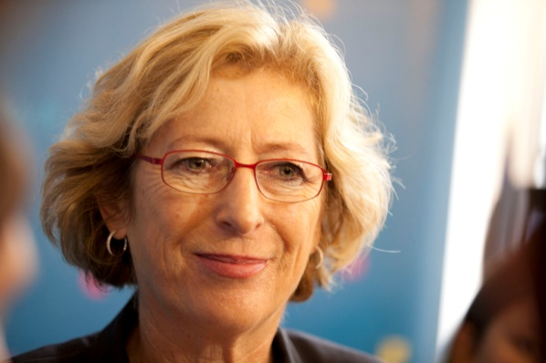
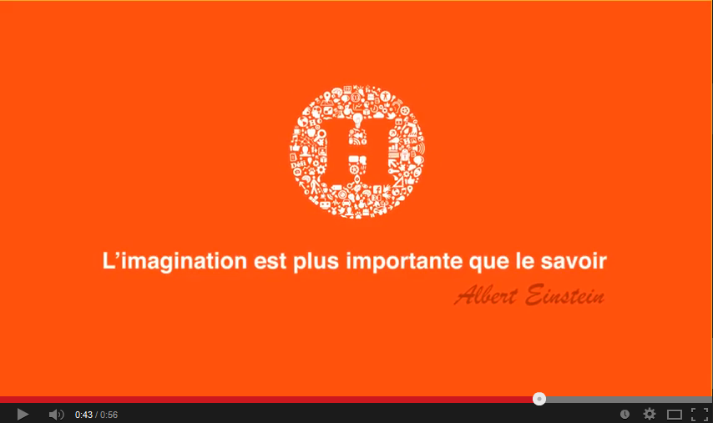
The 3rd edition in pictures
www.defih.com : web platform
dedicaded to the Défi H
Awards night
Geneviève Fioraso, secrétaire d'État chargée de
l'Enseignement supérieur et de la Recherche
Défi H & 3rd year
project présentation

